Slide 1
CADD training cohort-3 Assignment-2
Priyanka Rajan
4/17/26

Slide 2
Task-1 Drug likeness scoring
Compound Name | PubChem CID | SMILES
Coumarin | 323 | C1=CC=C2C(=C1)C=CC(=O)O2
Geraniol | 637566 | CC(=CCC/C(=C/CO)/C)C
Galantamine | 9651 | CN1CC[C@@]23C=C[C@@H](C[C@@H]2OC4=C(C=CC(=C34)C1)OC)O
These compounds are probable candidates for binding to Alzheimer’s protein Beta-secretase. Their PubChem CID and SMILES was retrieved from PubChem. Further their chemical structure was downloaded in the SDF format and opened in SwissADME software to determine drug-likeness. All 3 compunds showed no violation of Lipinski score.

Slide 3
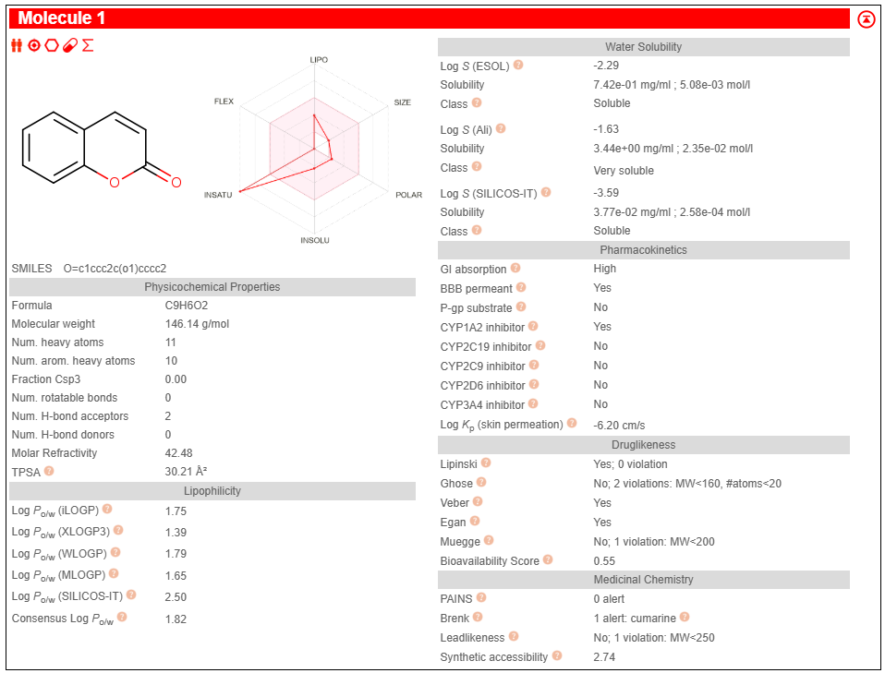
Coumarin

Slide 4
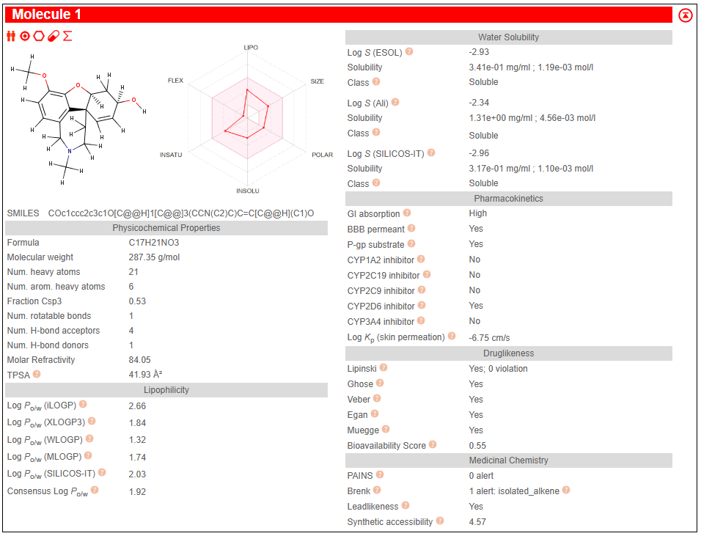
Galantamine

Slide 5
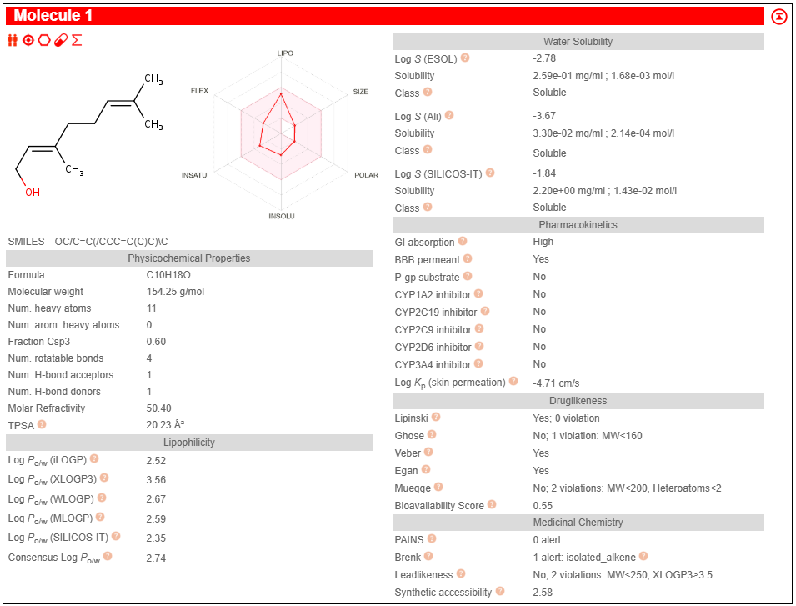
Geraniol

Slide 6
Task-2 Molecular docking and Visualization
Name | Ligand | Target | Binding Energy kcal/mol | Info
Coumarin | 323_mmff94_E=33.85 | 5QCU_dockprep | -6 | Vina
Galantamine | 9651_mmff94_E=69.95 | 5QCU_dockprep | -8.3 | Vina
Geraniol | 637566_mmff94_E=17.24 | 5QCU_dockprep | -5.8 | Vina
Docking gives a numerical value which represents the binding affinity between the ligand and protein. PyRx calculates binding energy in kcal/mol. It measures the Gibbs free energy of binding, which is the amount of energy released when the ligand binds to the protein. Since it is energy released, it has a negative sign. The lower the value, the lower the energy required for binding and the stronger the affinity.
-9.0 kcal/mol: very strong binding suggesting a high affinity hit for further investigation
-7.0 to -8.0 kcal/mol: Good binding. Most drug-like molecules are in this range
-5.0 to -6.0 kcal/mol: Moderate binding
-4.0 kcal/mol: Very weak or no binding

Slide 7
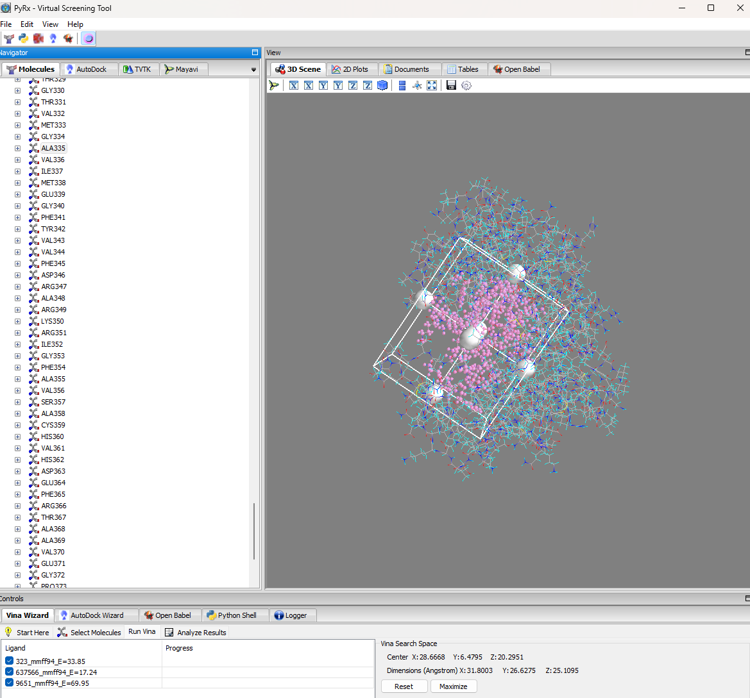

Slide 8
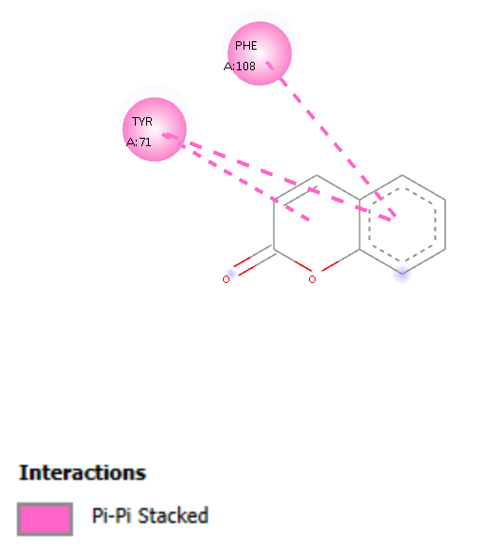
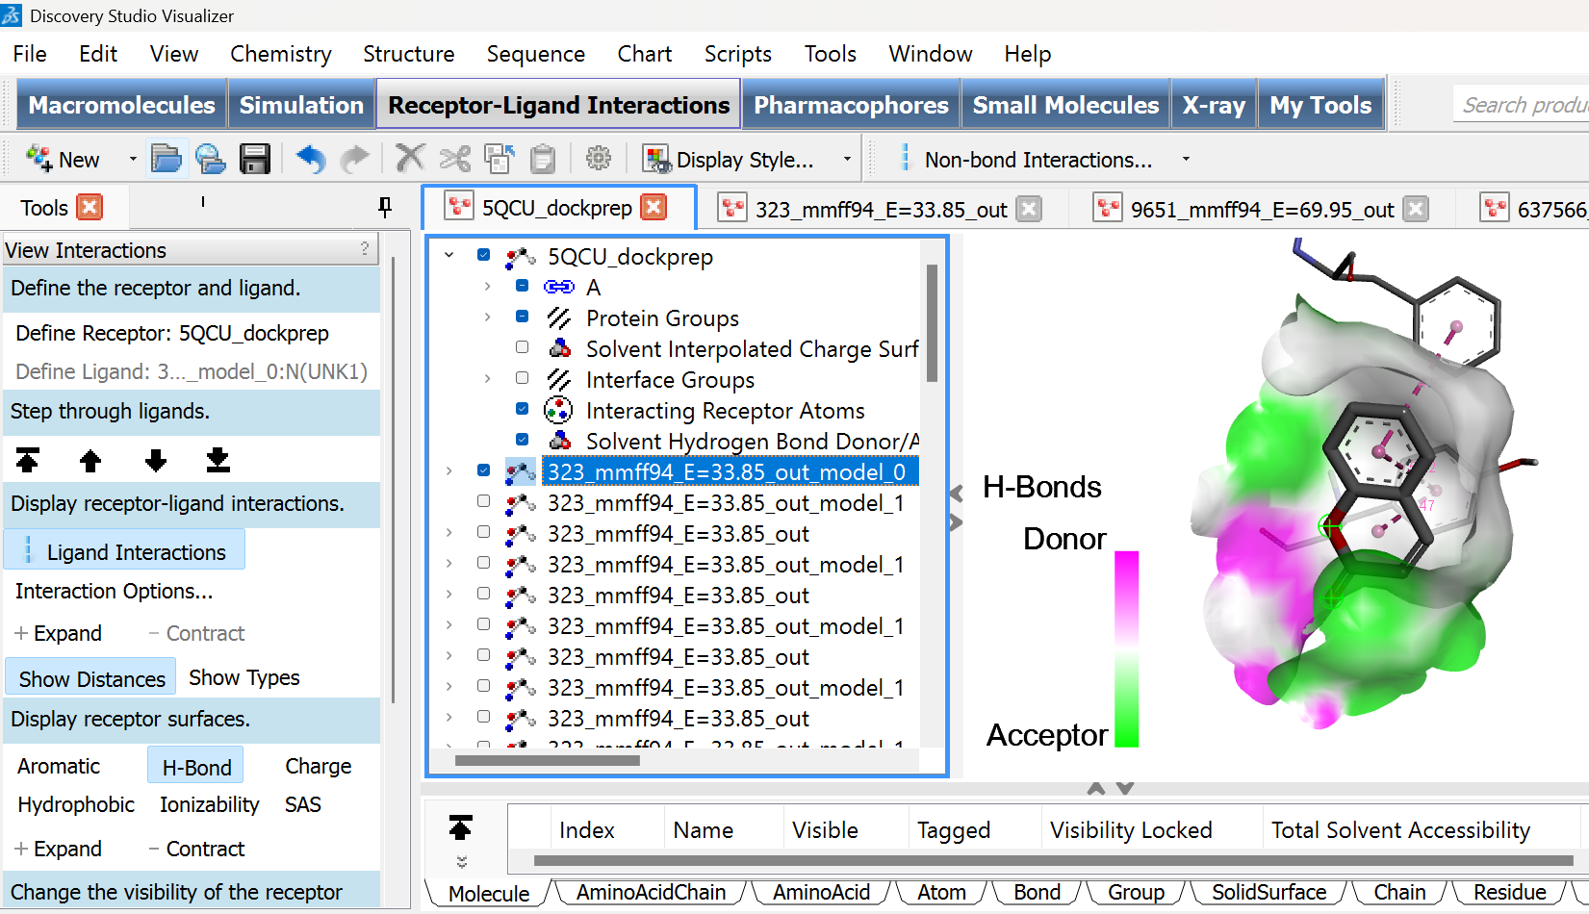
Coumarin(323) binding to BACE-1 (5QCU)

Slide 9
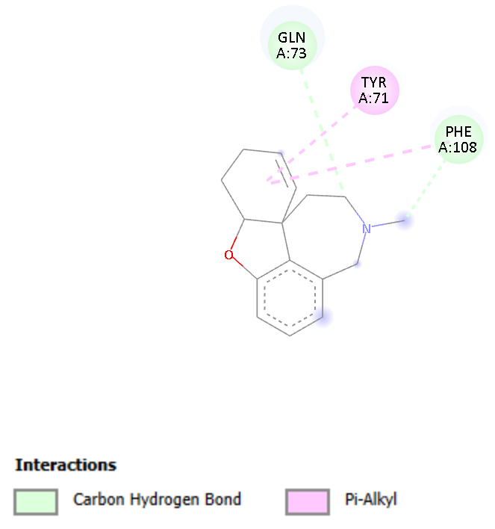
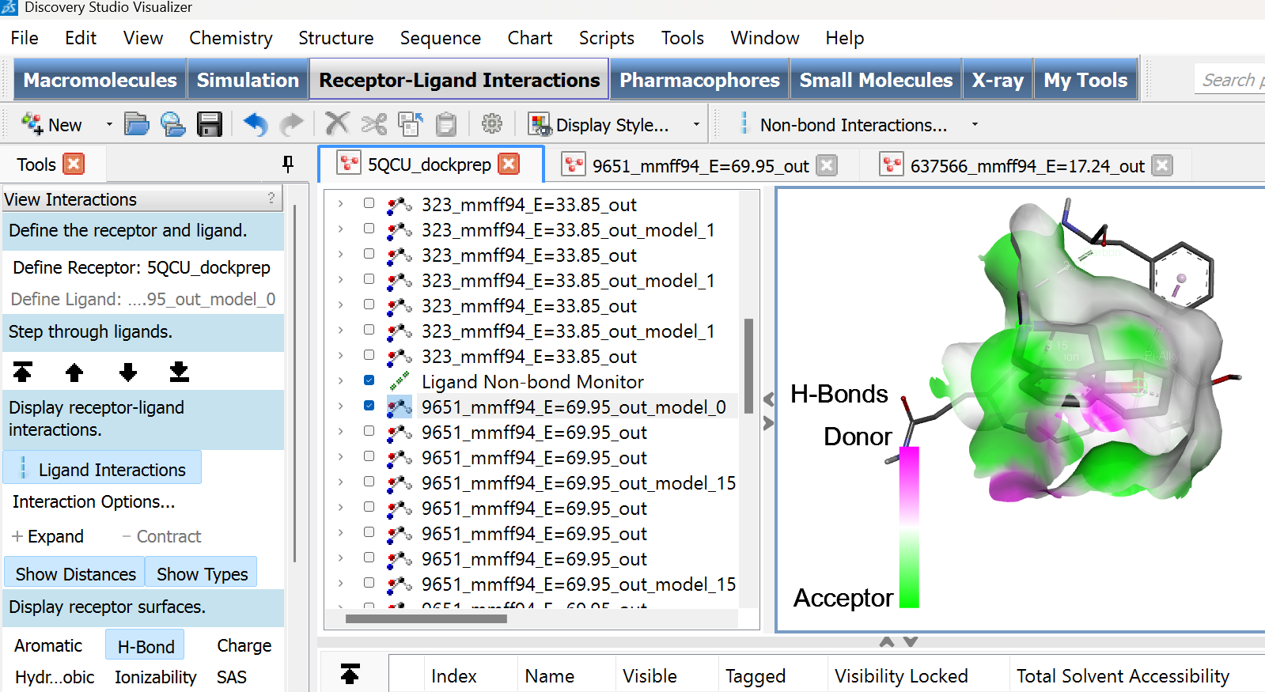
Galantamine(9651) binding to BACE-1 (5QCU)

Slide 10
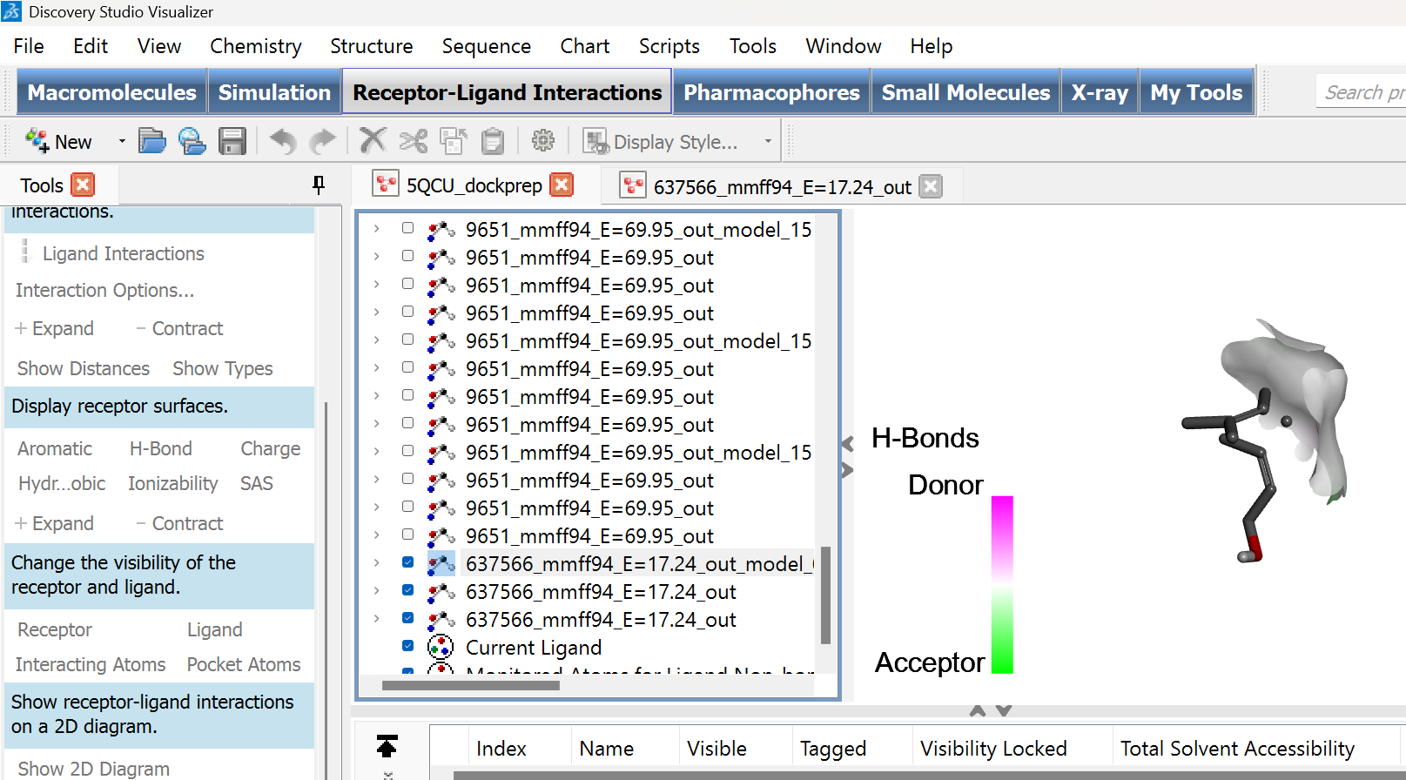
Geraniol(637566) binding to BACE-1 (5QCU)

